Slide 1

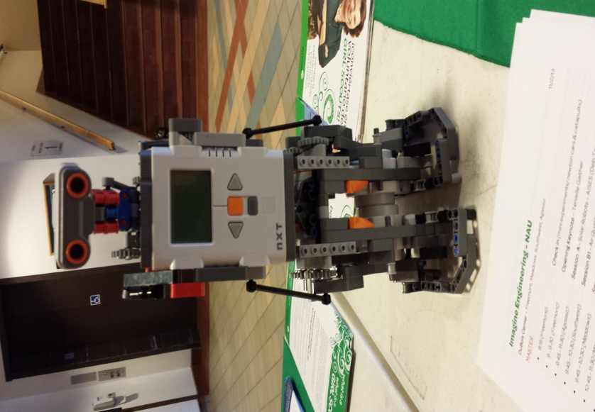


Robotic
Education
Patina Becenti
Mentor – Mansel Nelson

Slide 2
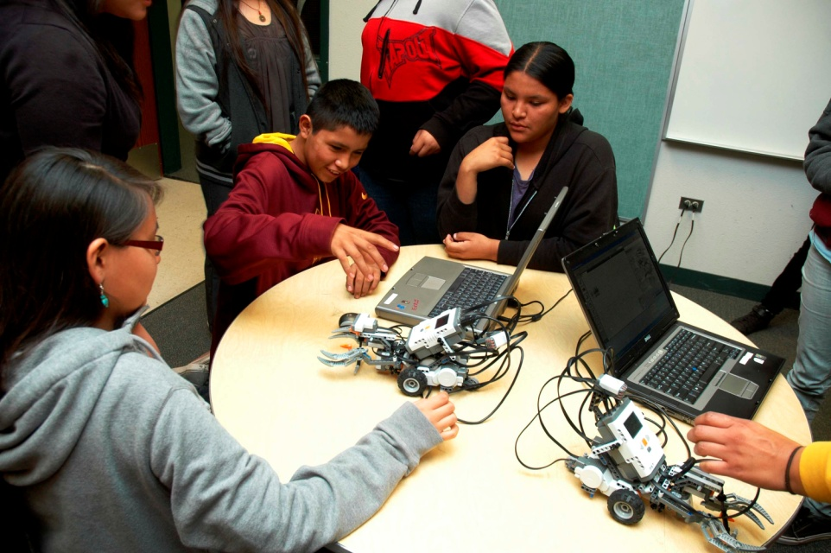
Introduction
The idea is to educate young students to explore the world of science and engineering.
Implement robotic education and outreach program in local schools, with a focus on schools that serve Native American students.
Students learned the basics of computer programming by programming the robot movement.

Slide 3
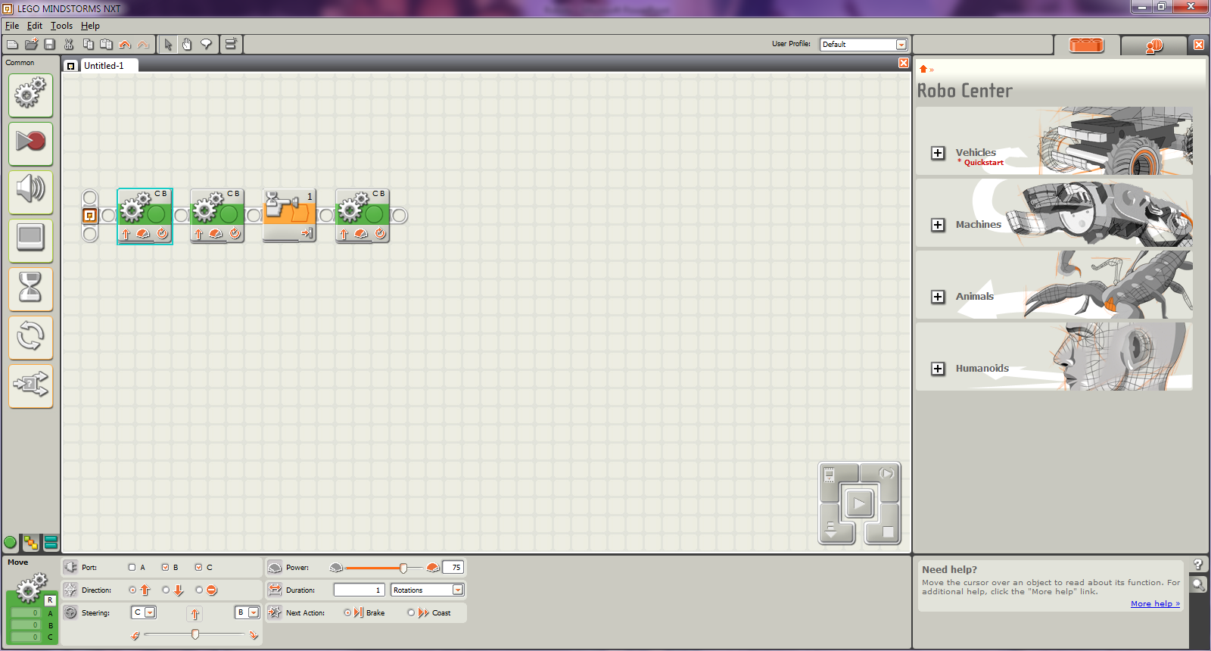
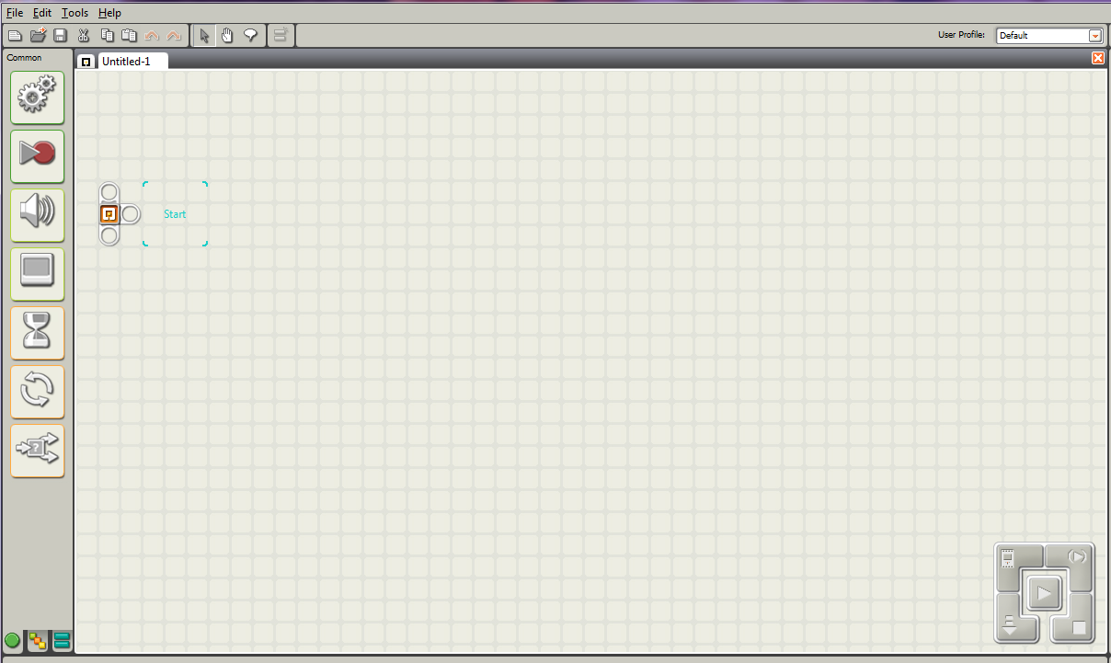
Lego Mindstorm NXT Program

Slide 4
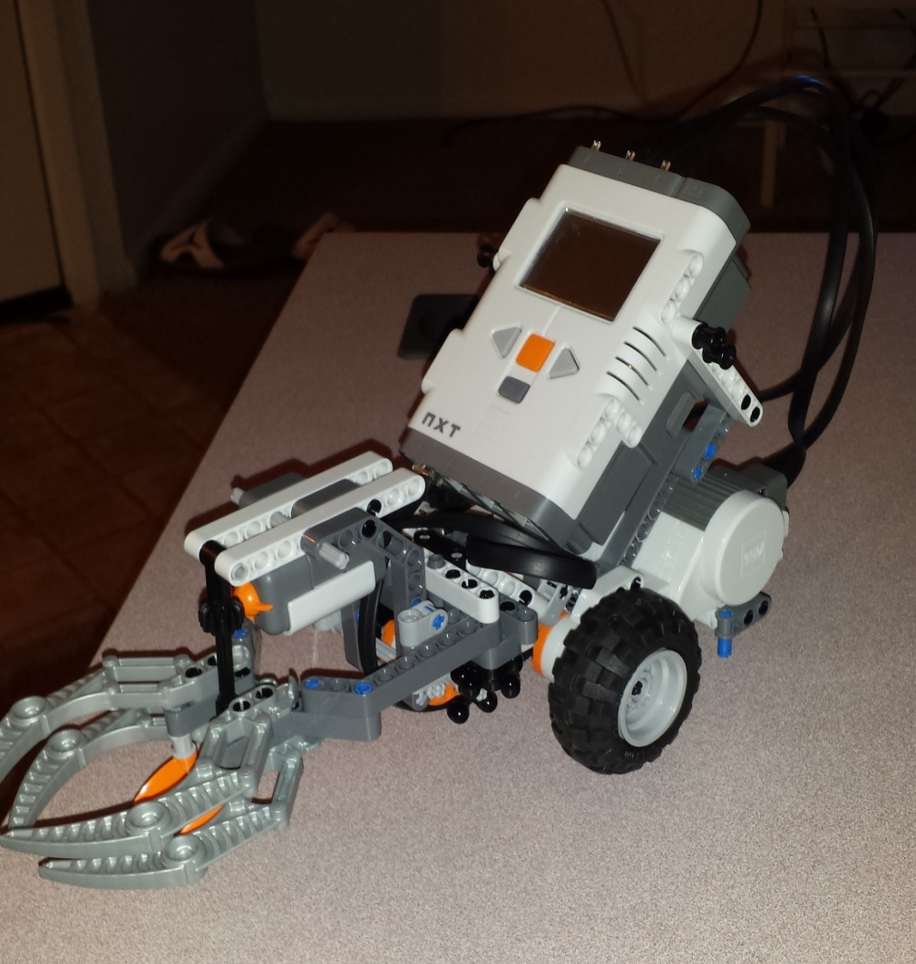
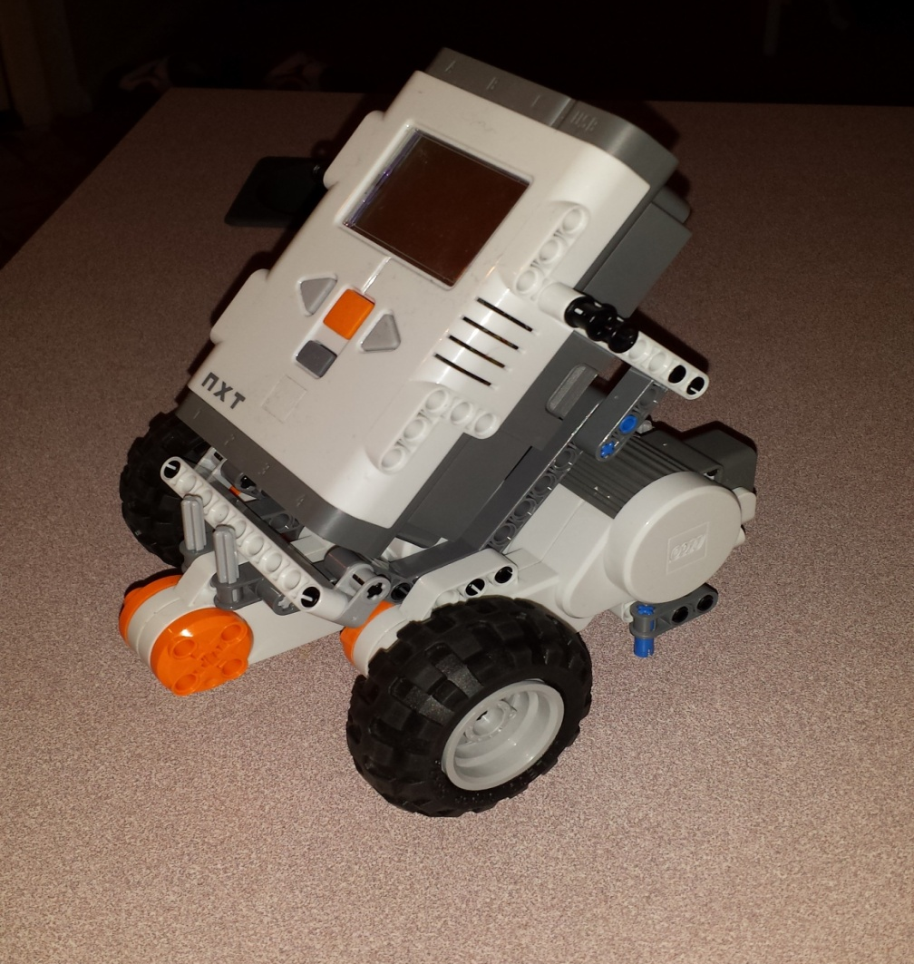
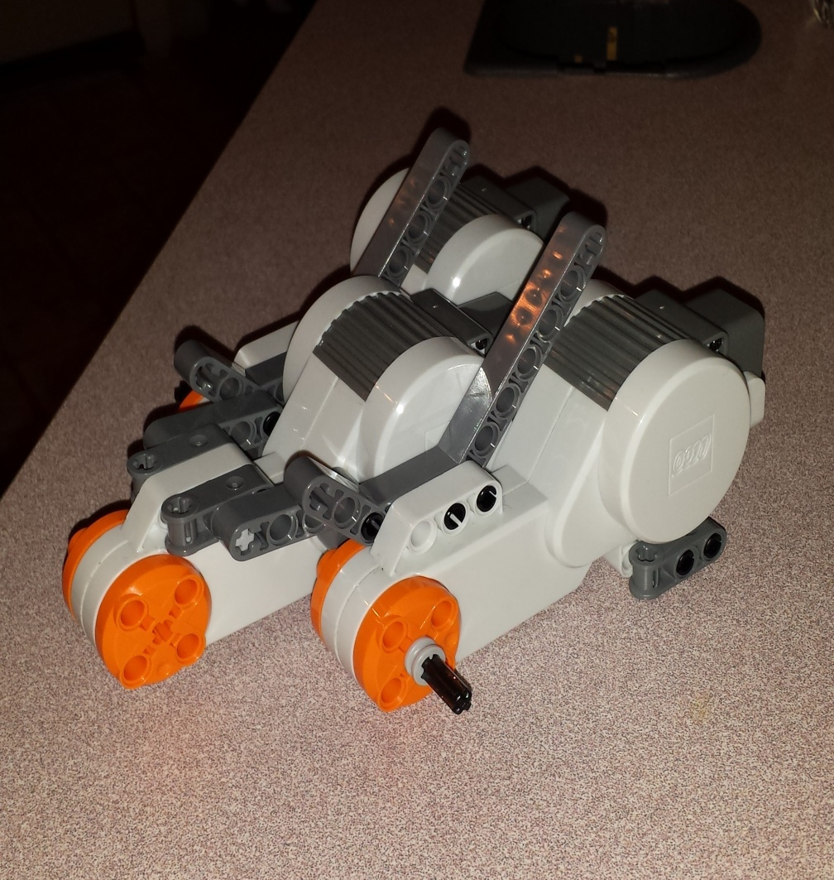
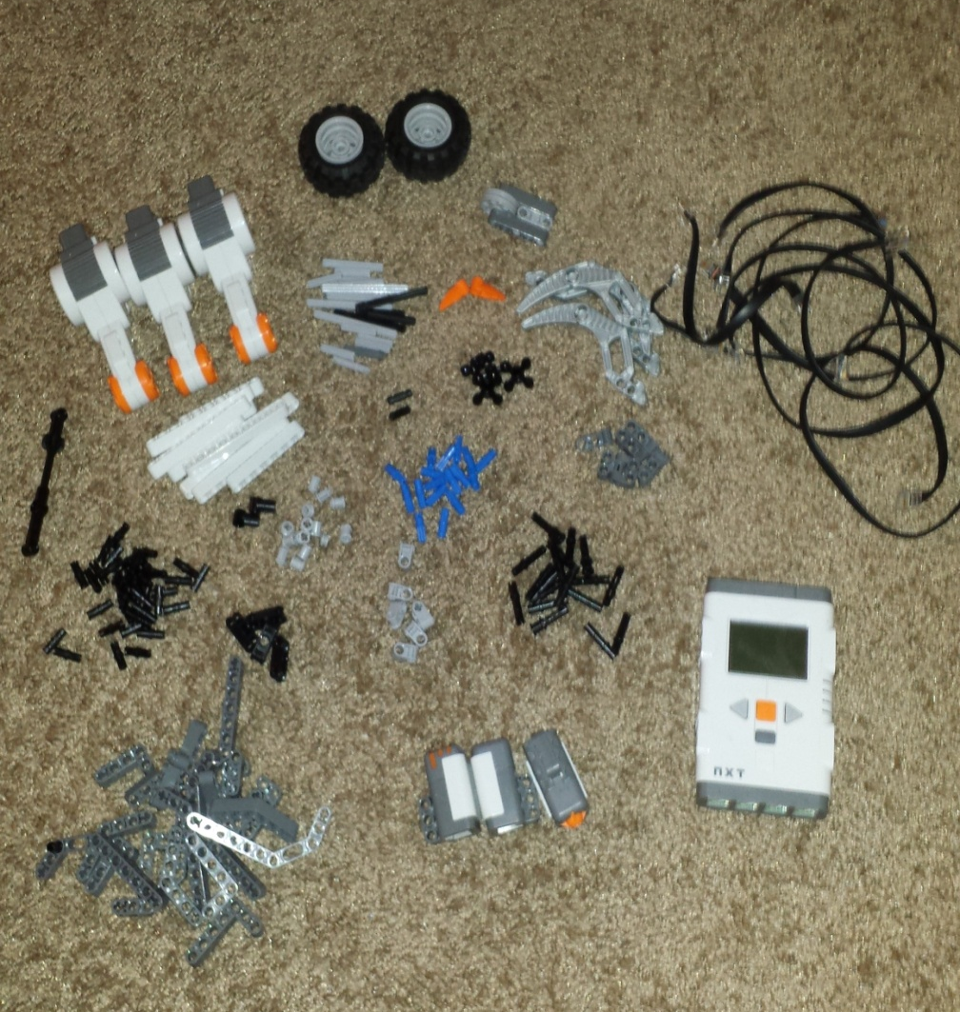
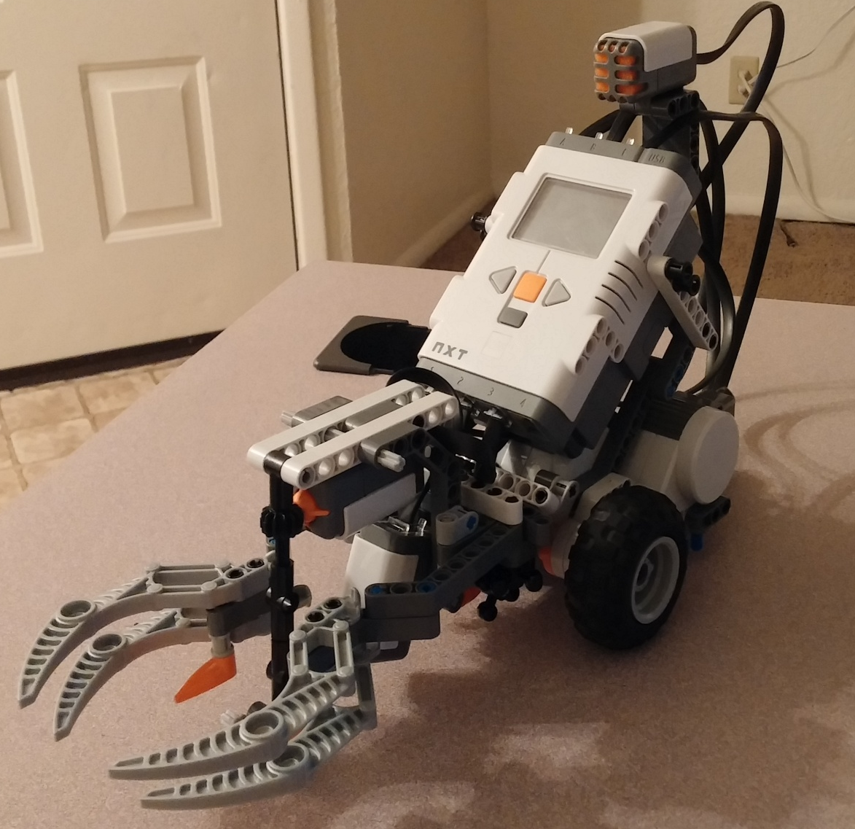
Lego Mindstorm Model
Build the robot out of Lego’s
Interactive Motor
NXT
Touch Sensor
Sound Sensor
Light Sensor

Slide 5
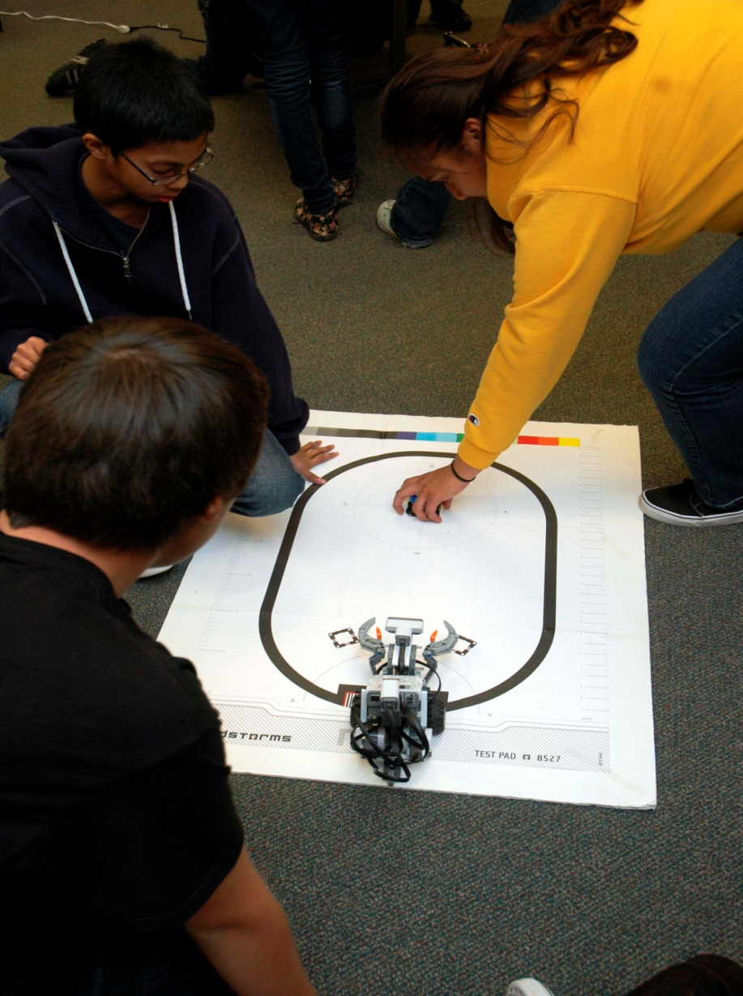
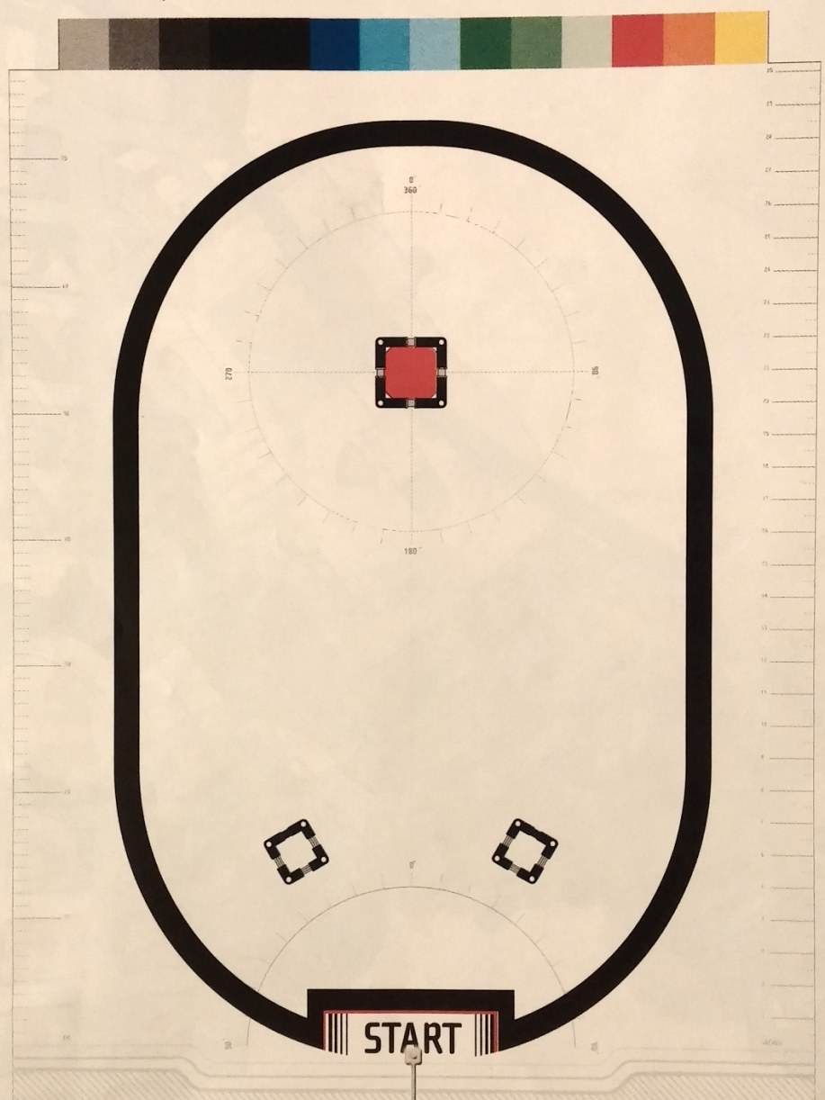
The Test Pad
Test your Robot and the program on the Pad.
Place the Robot on the test pad.
Move only when a ball is placed in front of it.

Slide 6
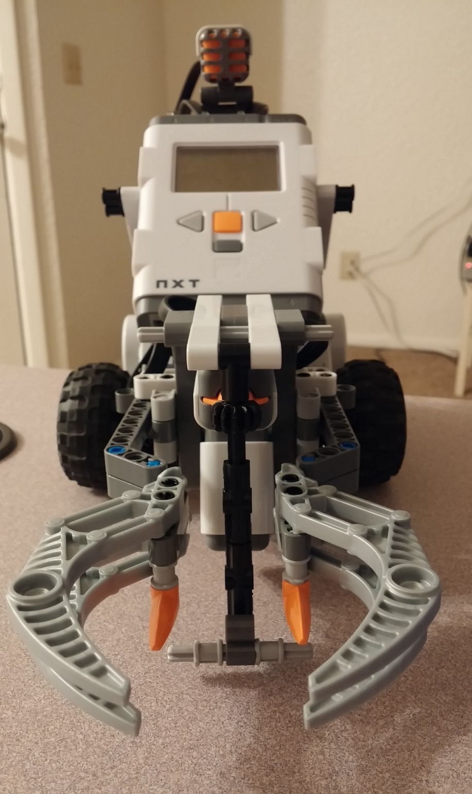
Grabber
Move forward until the Touch Sensor bumps into the ball.
Then stop.
Clap your hands once
Close the claws
Turn around and go back.
Open the claws when the robot reaches the black line.

Slide 7
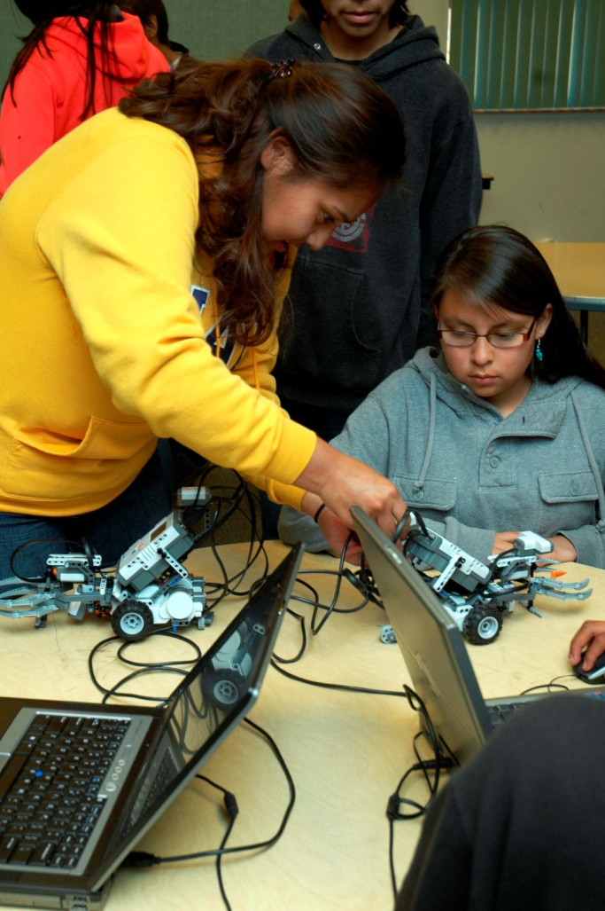
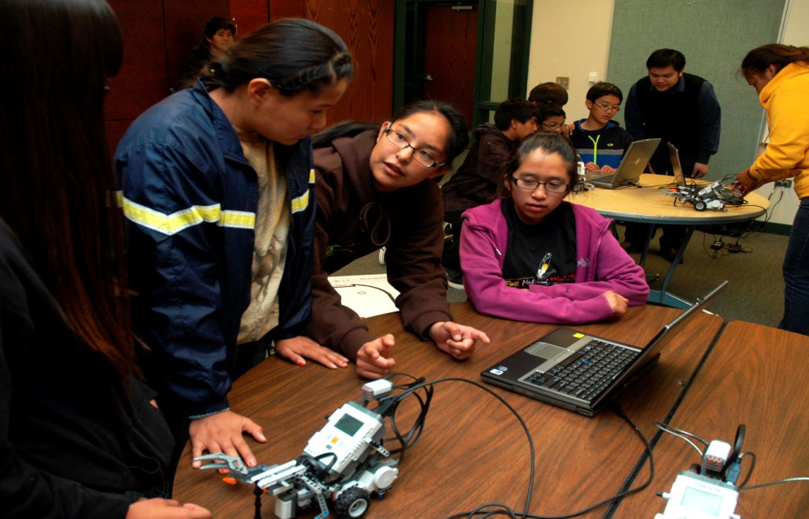
Schools
Tube City Junior High School
Red Mesa Junior High School
Keams Canyon

Slide 8
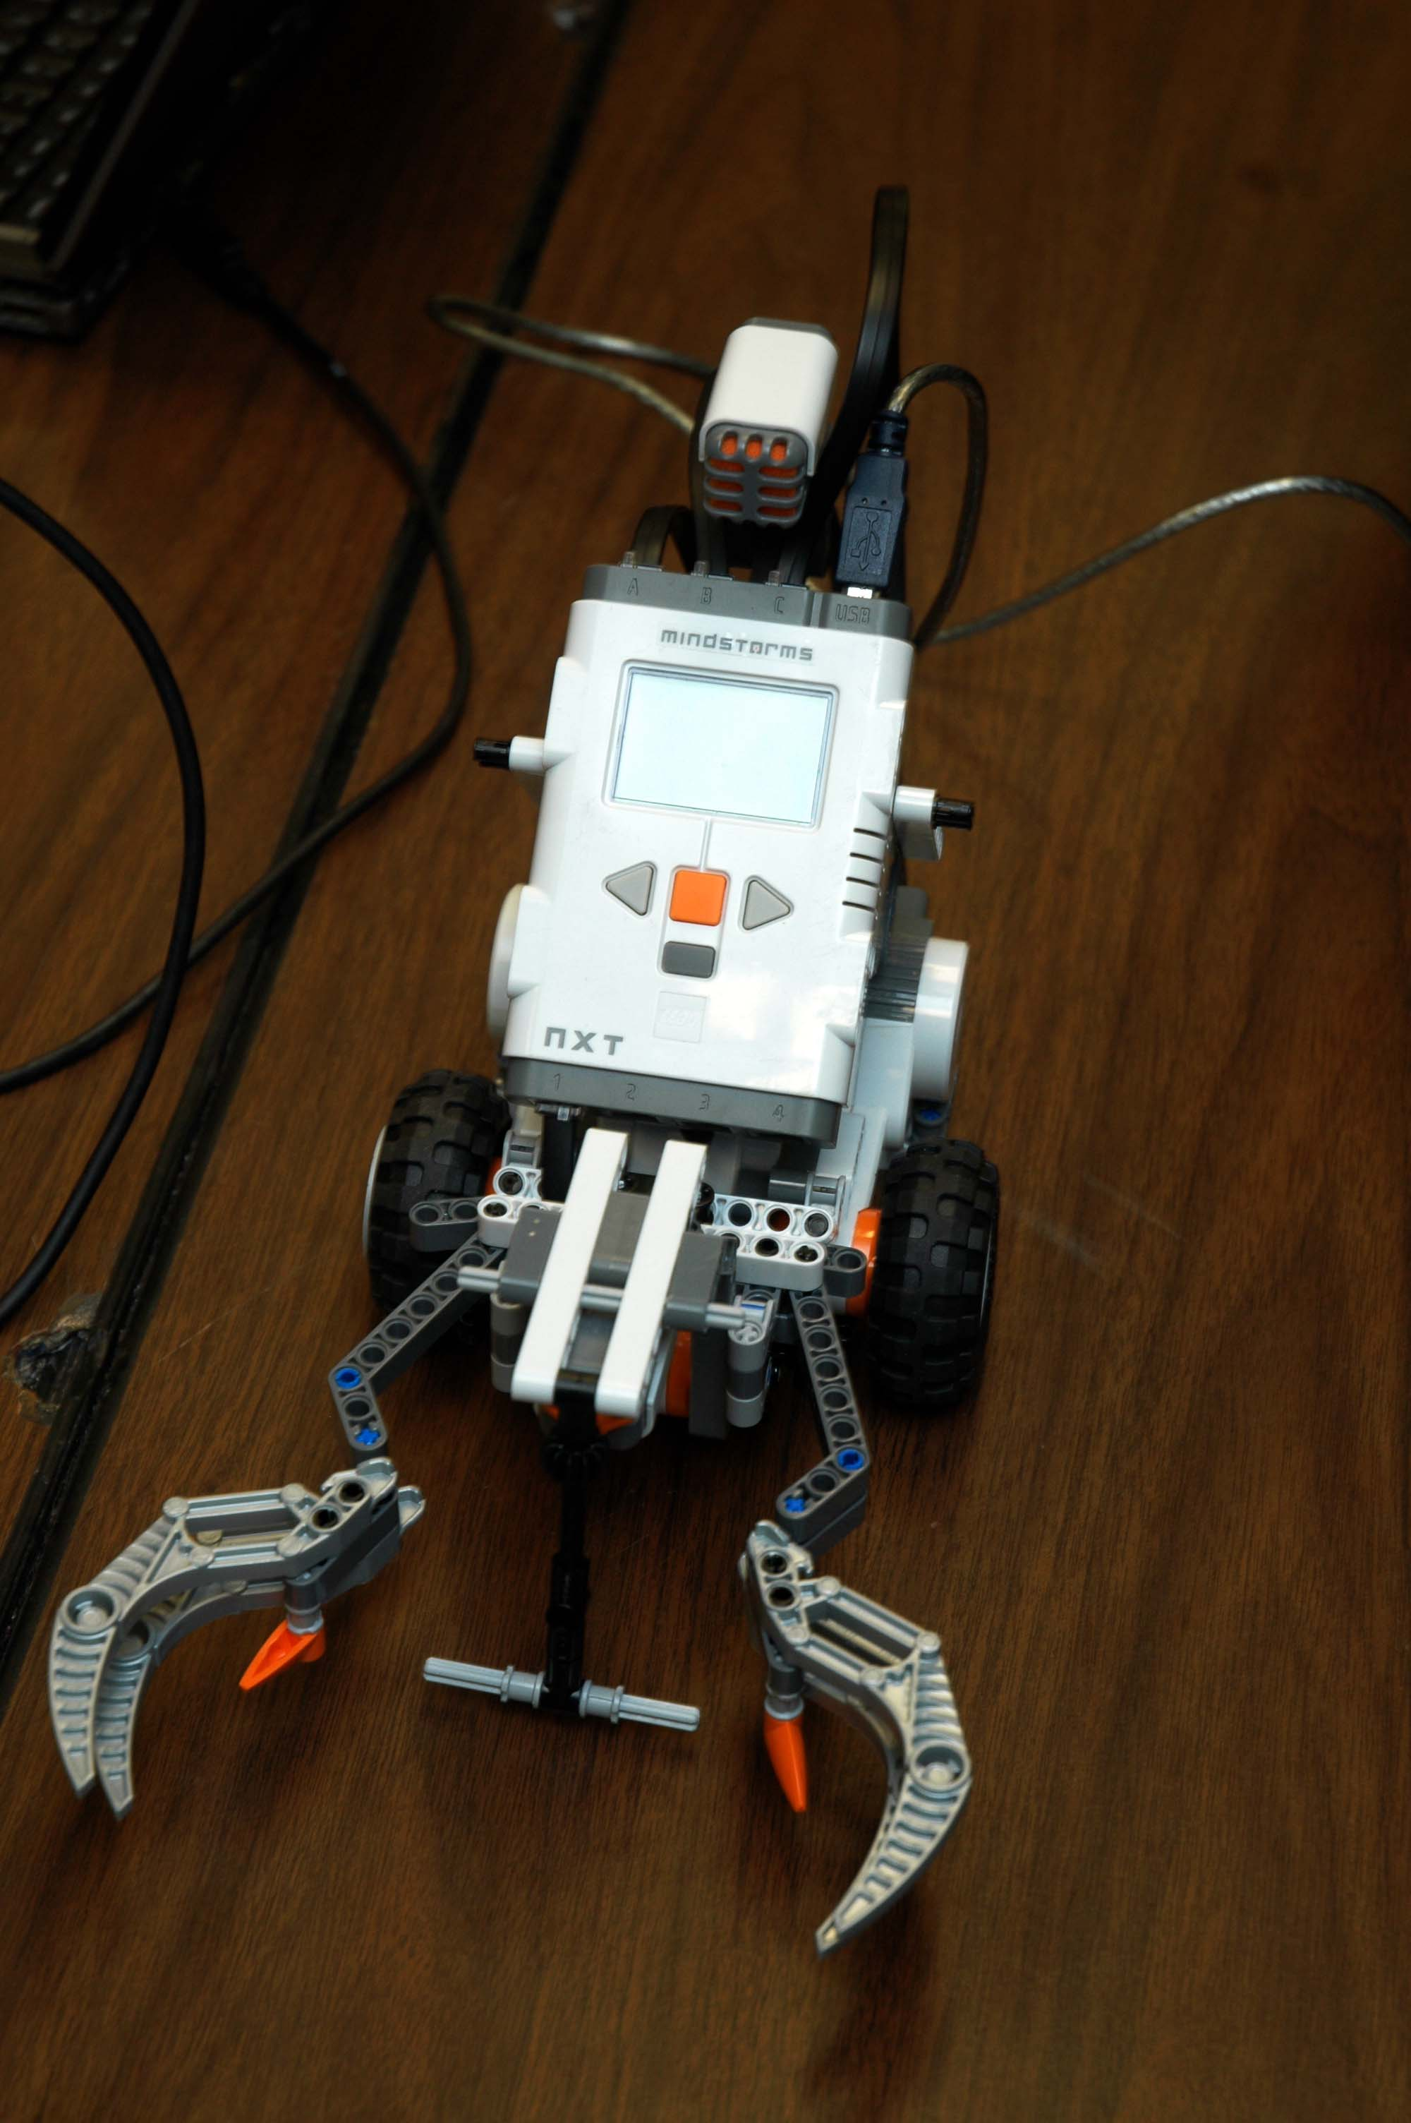
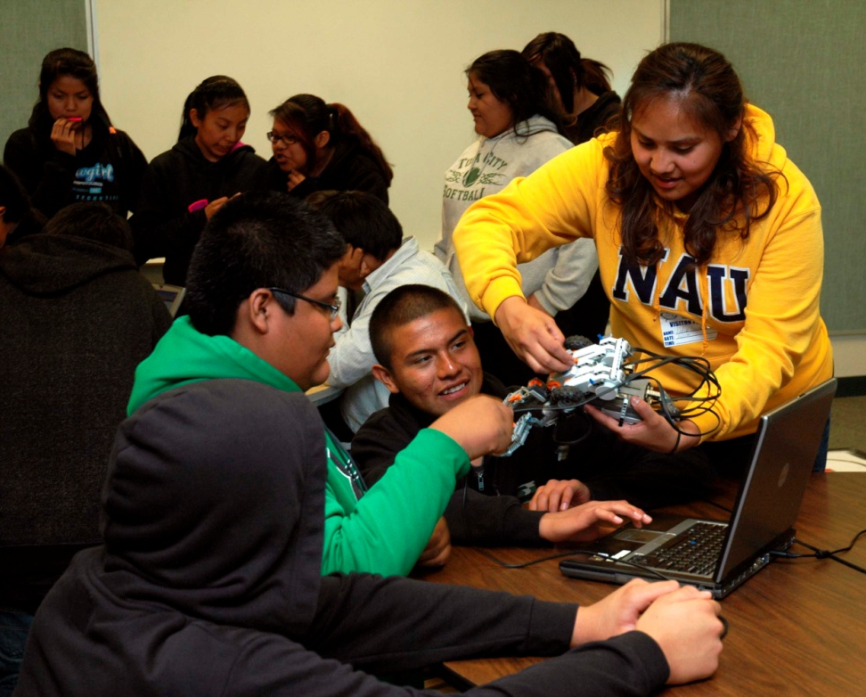
Questions?

Slide 9
Thank You
NASA Space Grant
Northern Arizona University
Mansel Nelson
EEOP Staff

